Slide 1

CS1.6
CAFE RESERVATION SYSTEM
Prakash Mahara
Shushil Mishra

Slide 2


CS1.6
Agenda
Introduction
Problem
Solution
Other
  Introduction
  Problem
  Solution
  Objective
  Literature Review
  Future Plan
  Technical Part
  Methodology

Slide 3
CS1.6
Agenda
Introduction
Problem
Solution
Other
Introducing an online web app platform where customers can reserve a cafe's table without the need to visit the cafe physically.

Slide 4

CS1.6
Agenda
Introduction
Problem
Solution
Other
  Service Delays:
Customers face delays in booking table and getting a menu.
  Extended Wait Times:
Customers may have to wait until cafe's table available for booking.

Slide 5

CS1.6
Agenda
Introduction
Problem
Solution
Other
  Project introduces a digital menu to eliminate these delays.
  Project introduces online reservation platform where customers can book tables online.

Slide 6

CS1.6
Agenda
Introduction
Problem
Solution
Other
Objectives:
  To make an efficient cafe's table booking system.
  To provide the customer instant access to the Café table and menu.
  To provide customers options to choose their seats.

Slide 7

CS1.6
Agenda
Introduction
Problem
Solution
Other
Literature Review:
In the past few years, it is experienced that customers are desirous to find a handy application for reservation of tables and menu or any other services to avoid physical walking to the cafe or contacting by call or reserving through a middle man.
Bringing a platform which provides café table booking was encouraged by the customers very much as well as the orders have been increasing day by day when compared to previous years. This platform is helpful not only for the customers but also useful for café receptionist to manage their management

Slide 8
CS1.6
Agenda
Introduction
Problem
Solution
Other
Future Plan:
  Mobile app integration:
Offering a mobile app would enhance user accessibility and convenience.
  Payment integration:
Online payment processing portal supporting all mobile wallets.
  Specific Date and Time Booking:
Customers can book a table for up to the next 7 days for a specific time and date

Slide 9
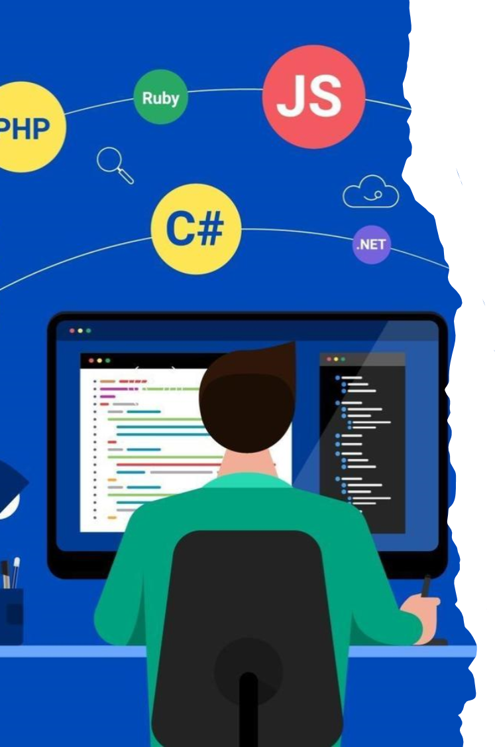
Agenda
Introduction
Problem
Solution
Other
Technical Part:
Frontend: HTML, CSS, Bootstrap
Backend: PHP
Database: MySQl
CS1.6

Slide 10
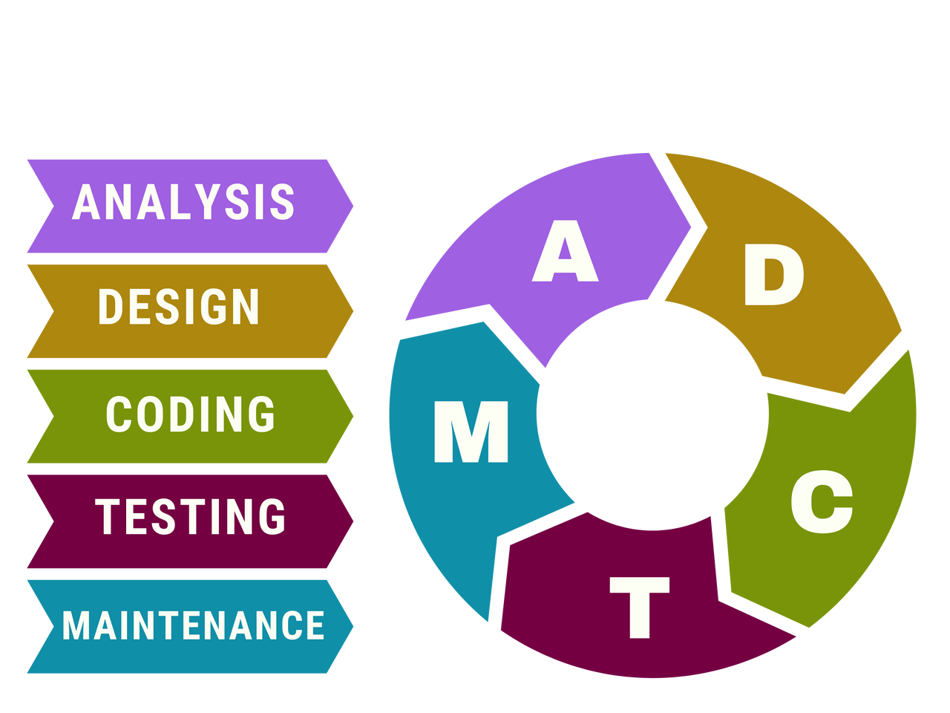
CS1.6
Agenda
Introduction
Problem
Solution
Other
Methodology:
The Waterfall Model is a traditional and linear approach to software development.

Slide 11
CS1.6
Agenda
Introduction
Problem
Solution
Other
Thank You

